Slide 1



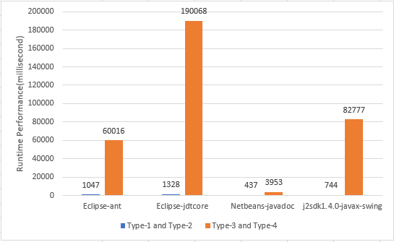
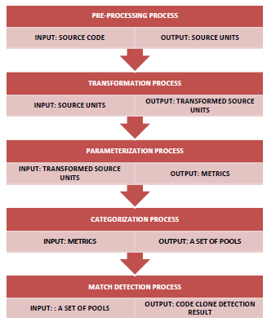
ENHANCEMENT OF GENERIC CODE CLONE DETECTION FOR JAVA APPLICATION USING STRING WEIGHTAGE
FACULTY OF COMPUTER SYSTEM & SOFTWARE ENGINEERING
STUDENT : KIROSHINII A/P NAGALINGAM [ CA16103 ]
SUPERVISOR : DR AL-FAHIM BIN MUBARAK ALI
ABSTRACT
PROBLEM STATEMENT
SCOPE
Generic Code Clone Detection (GCCD) model that consists of five processes has been proposed to detect Type-1, Type-2, Type-3 and Type-4 code clone. overcome drawback of the existing models through the automated calculation of code clone detection result and better visualization of the code clone detection results.
Challenge faced in detecting code clone using model is the lack of detecting all code clone type.
Use of different code clone detection approaches that produce different representation of the source code.
Code clone type refers to the type of code clone detected and granularity level of the code clone type is based on clone pair.
Programming language that focuses on the code clone detection in application that contain Java source codes only.
:
INTRODUCTION
METHODOLOGY
RESULT
This work presents the prototype of GCCD developed that consist of five processes that can support the detection of different code clone types in Java applications using string weightage. The mostly used terminology for code clones is classified into four types which is Type-1, Type-2, Type-3 and Type-4.
GENERIC CODE CLONE DETECTION MODEL (GCCD)
OBJECTIVE
To enhance the pre-processing and transformation process that improves the representation of the source units.
To propose string weightage concept for better detection result.
To evaluate the improvement of code clone detection result.
CONCLUSION
The GCCD consist of five processes that can support detection of Type-1, Type-2, Type-3 and Type-4 code clone types with improved code clone categories. The string concept is applied because String is the most contained and used attributes in any application.

